Slide 1

Amity School of Engineering and Technology
HAND GESTURE RECOGNITION SYSTEM
MAJOR PROJECT – 2021
SUBMITTED TO : MR.RAJ KUMAR GUPTA SIR
SUBMITTED BY : M.KEERTHI SUMANTH
A20405117003
N.KRISHNA SIDHVI
A20405117004

Slide 2
CONTENTS
INTRODUCTION
EXISTING SYSTEM
PROPOSED SYSTEM
DATA SETS
ULM DIAGRAMS
ARCHITECTURE
MODULES
SOFTWARE AND HARDWARE REQUIREMENTS
ALGORITHMS
OUTPUT

Slide 3

INTRODUCTION
Gestures are a form of nonverbal communication in which visible bodily actions are used to communicate important messages, either in place of speech or together and in parallel with spoken words. In a world with multiple modes and languages used for communication, it’s a tedious task to be what everyone calls a global citizen. Hand gestures is a medium through which information can be conveyed irrespective of your origin, mother-tongue and best of all, disability.
The aim of this project is to develop an interactive interface that captures an image of a hand gesture and correctly predicts and displays the letter that the hand gesture represents. This tool can help ameliorate the problems faced by the Individuals with speaking and hearing disabilities, family members who constantly need to communicate with individuals with the disabilities as listed above, teachers present in institutions that cater to the needs of the differently abled and doctors and nurses who attempt to understand the ailments of the differently abled individuals. The images captured from the web camera are initially transformed, following this, the features based on which the model is trained are extracted, and an accurate prediction of the hand gesture is made and the same is displayed. In this system, feature detection and feature extraction of hand gesture is done with the help of CNN and openCV.

Slide 4

EXISTING SYSTEM
A glove that translates sign language into speech in real time has been developed
The wearable device contains sensors that run along the four fingers and thumb to identify each word, phrase or letter as it is made in American Sign Language.

Slide 5

PROPOSED SYSTEM
Converting hand gestures into text
Training Dataset consists of images captured by using a video camera, thereby facilitating the comparison of features for hand gestures.
Image transformation algorithms are applied to each of the training images, therefore any new training dataset can also be used.
Our system contains Data collection, Data preparation, Image analysis, Feature extraction, Image classification, Image to text conversion

Slide 6
Who can use it?
Individuals with speaking and hearing disabilities.
Family members who constantly need to communicate with individuals with the disabilities as listed above.
Teachers present in institutions that cater to the needs of the differently disabled.
Doctors and Nurses who attempt to understand the differently abled individuals.

Slide 7
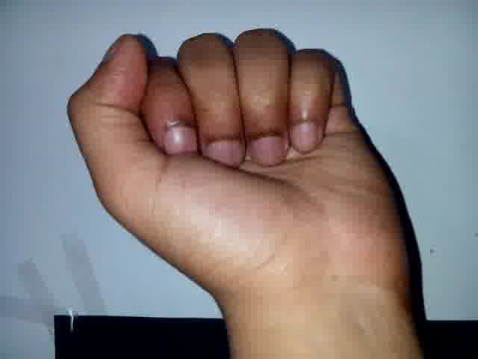
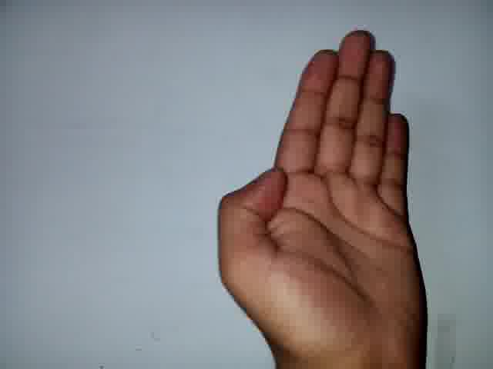
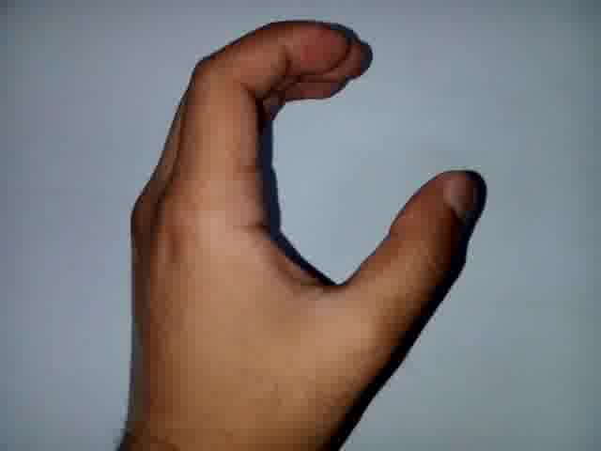
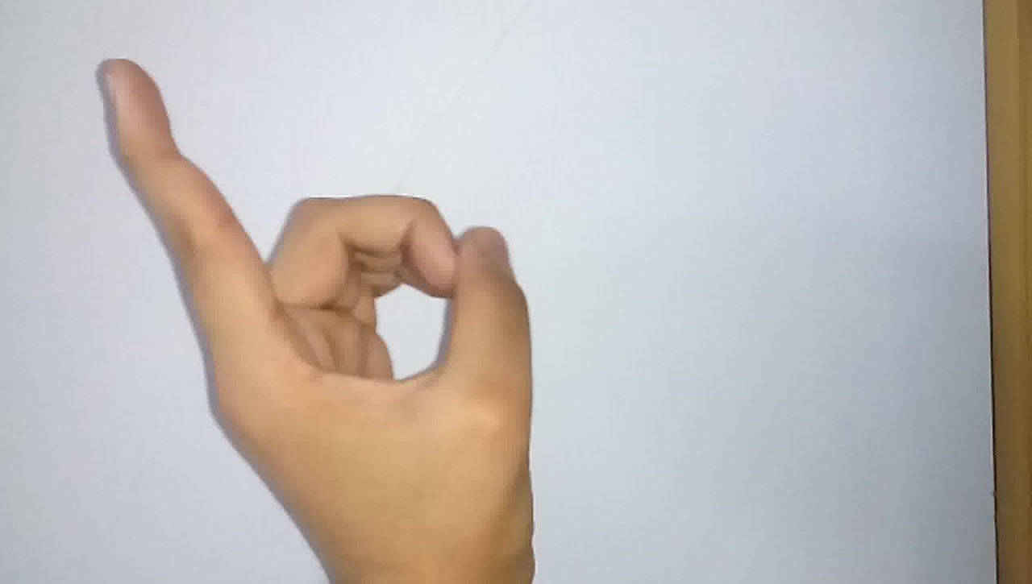
DATA SETS

Slide 8
UML Diagrams

Slide 9
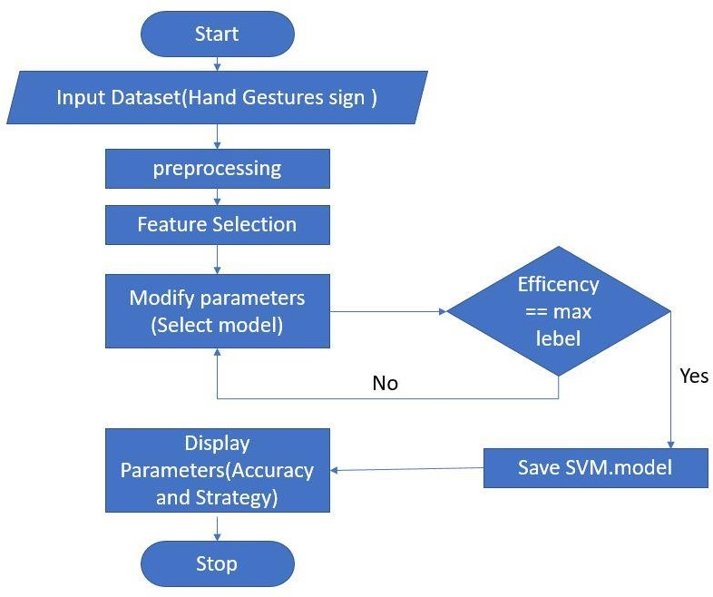
Flow chart
For Hand gesture recognition system

Slide 10
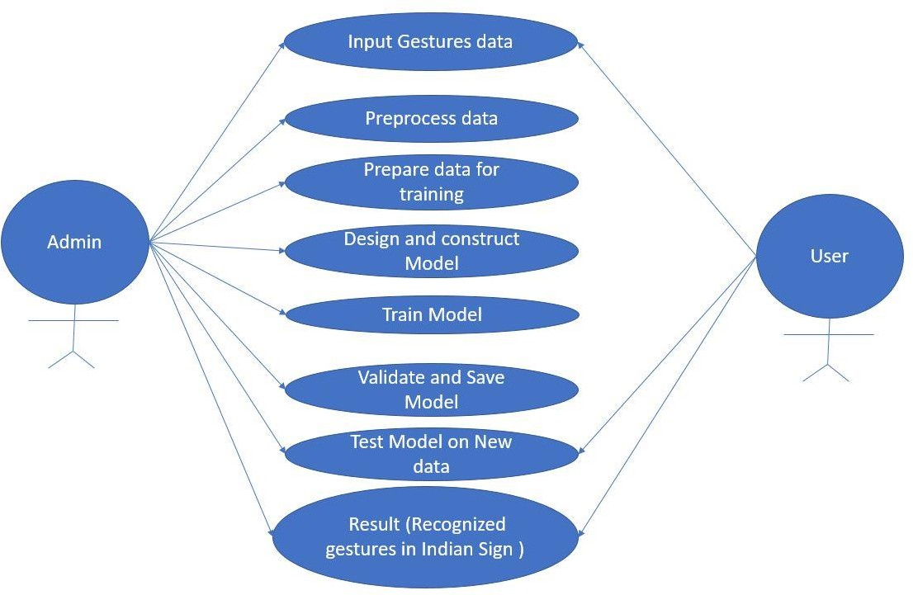
Use Case Diagram

Slide 11
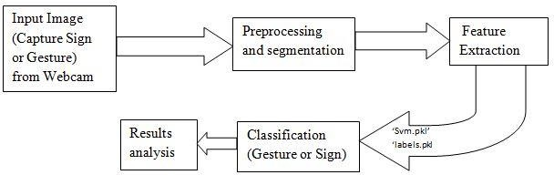
ARCHITECTURE

Slide 12
MODULES Dataset collection: In this stage data set is collecting by running camera and pictures are captured for each gesture and folder is saved with one alphabet for each gesture. Preprocessing: In this stage data set is preprocessing by converting images to required size and images are covered to required background corrections. Splitting Dataset: Data set is divided into folders features and labels and where features are images signs and labels are alphabets. Initialize algorithm: In this stage CNN algorithm is used and training data is fit in to algorithm .

Slide 13
MODULES Save Model: After training data is saved as .h5 model which is used for predicting purpose in future. Predict: In this stage live camera will open and signs are given by user based on signs alphabets will be displayed on camera.

Slide 14
SOFTWARE AND HARDWARE REQUIREMENTS Hardware Requirements: Processor : Any Processor above 500 MHz RAM : 2 GB Hard Disk : 80 GB Software Requirements: Operating system : Windows 7/8/10 IDE : Python, Anaconda Navigator Programming Language : Python Dataset : own gesture dataset

Slide 15
ALGORITHMS CNN Algorithm Steps 1.collecting dataset 2.preprocessing 3.testing and training 4. save model 5. predict

Slide 16
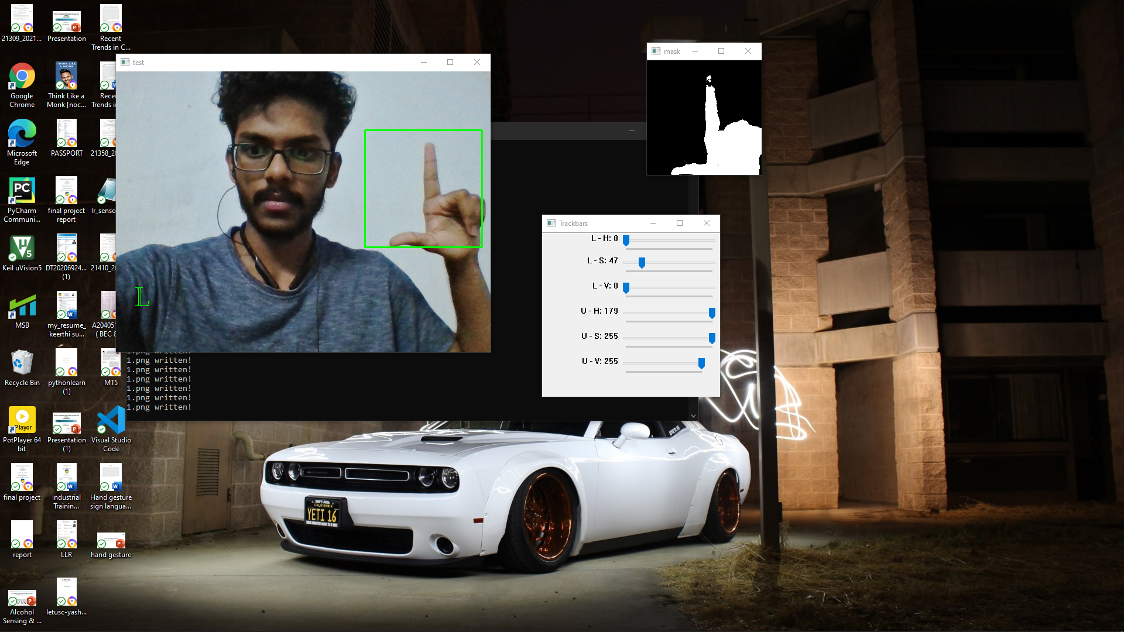
OUTPUT:

Slide 17
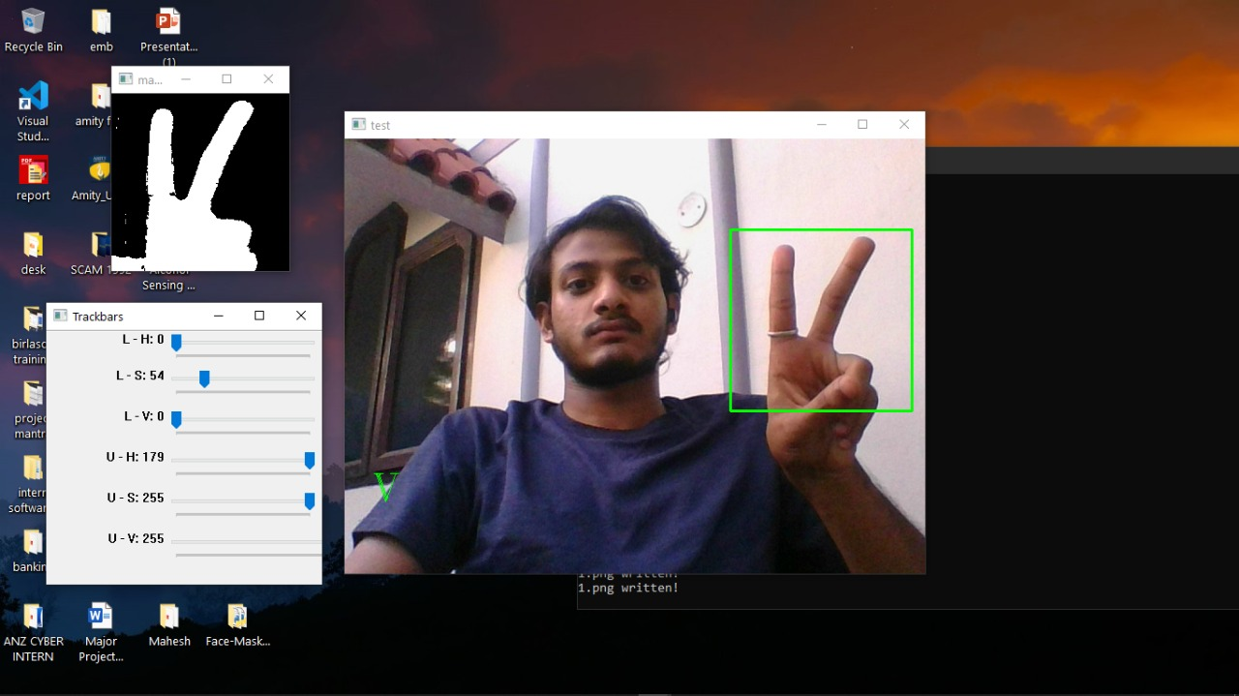

Slide 19
References:
A. Chaudhary, J.L. Raheja, K. Das, S. Raheja, "A Survey on Hand Gesture Recognition in context of Soft Computing", Published as Book Chapter in “Advanced Computing” CCIS, Springer Berlin Heidelberg, Vol. 133, 2011, pp. 46-55
A. Chaudhary, J.L. Raheja, K. Das, “A Vision based Real Time System to Control Remote Robotic hand Fingers”, In proceedings of the IEEE International Conference on Computer Control and Automation, South Korea, 1-3 May, 2011, pp. 118-122
J.L. Raheja, A. Chaudhary, S. Maheshwari, “Automatic Gesture Pointing Location Detection”, Optik: International Journal for Light and Electron Optics, Elsevier, Vol. 125, Issue 3, 2014, pp. 993-996.
A. Chaudhary, K. Vatwani, T. Agrawal, J.L. Raheja, “A Vision-Based Method to Find Fingertips in a Closed Hand”, Journal of Information Processing Systems, Korea, Vol. 8, No. 3, Sep 2012, pp. 399-408.
A. Chaudhary, J.L. Raheja, K. Das, S. Raheja, “Fingers' Angle Calculation using Level-Set Method”, Published as Book Chapter in “Computer Vision and Image Processing in Intelligent Systems and Multimedia Technologies”, IGI,USA, April 2014, pp.191-202

Slide 20
D. Sturman, D. Zeltzer, “A survey of glove-based input”, IEEE Transactions on Computer Graphics and Applications, Vol. 14, No. 1, Jan. 1994, pp. 30-39.
T.S. Huang, and V.I. Pavlovic, “Hand gesture modeling, analysis and synthesis”, Proceedings of international workshop on automatic face and gesture recognition, 1995, pp.73-79.
O.Y. Cho, and et al. “A hand gestue recognition system for interactive virtual environment”, IEEK, 36-s(4), 1999, pp. 70-82.
M. Sonka, V. Hlavac, R. Boyle, "Image processing, analysis, and machine vision"2014, Cengage Learning.
A. Chaudhary, M. B. L. Manasa, J.L. Raheja, “Light invariant Neuro-Vision System for Elder/Sick people to express their needs into Lingual Description”, Microsoft Research India's annual research symposium TechVista, India, 20 Jan, 2012.
A. Chaudhary, J.L. Raheja, "ABHIVYAKTI: A Vision Based Intelligent System for Elder and Sick Persons”, In proceedings of the 3rd IEEE International Conference on Machine Vision, Hong Kong, 28-30 Dec, 2010, pp. 361-364.

Slide 21
J L Raheja, Dhiraj, D Gopinath, A. Chaudhary, “GUI System for Elder/Patients in Intensive Care”, In proceedings of the 4th IEEE International Conference on International Technology Management Conference, Chicago, IL USA, 12-15 June, 2014, pp.1-5.
J. Rekha, J. Bhattacharya and S. Majumder, "Hand Gesture Recognition for Sign Language: A New Hybrid Approach", 15th IPCV'11, July, 2011, Nevada, USA.
A.W. Fitzgibbon, and J. Lockton, “Hand Gesture Recognition Using Computer Vision”, BSc. Graduation Project, Oxford University.

Slide 22
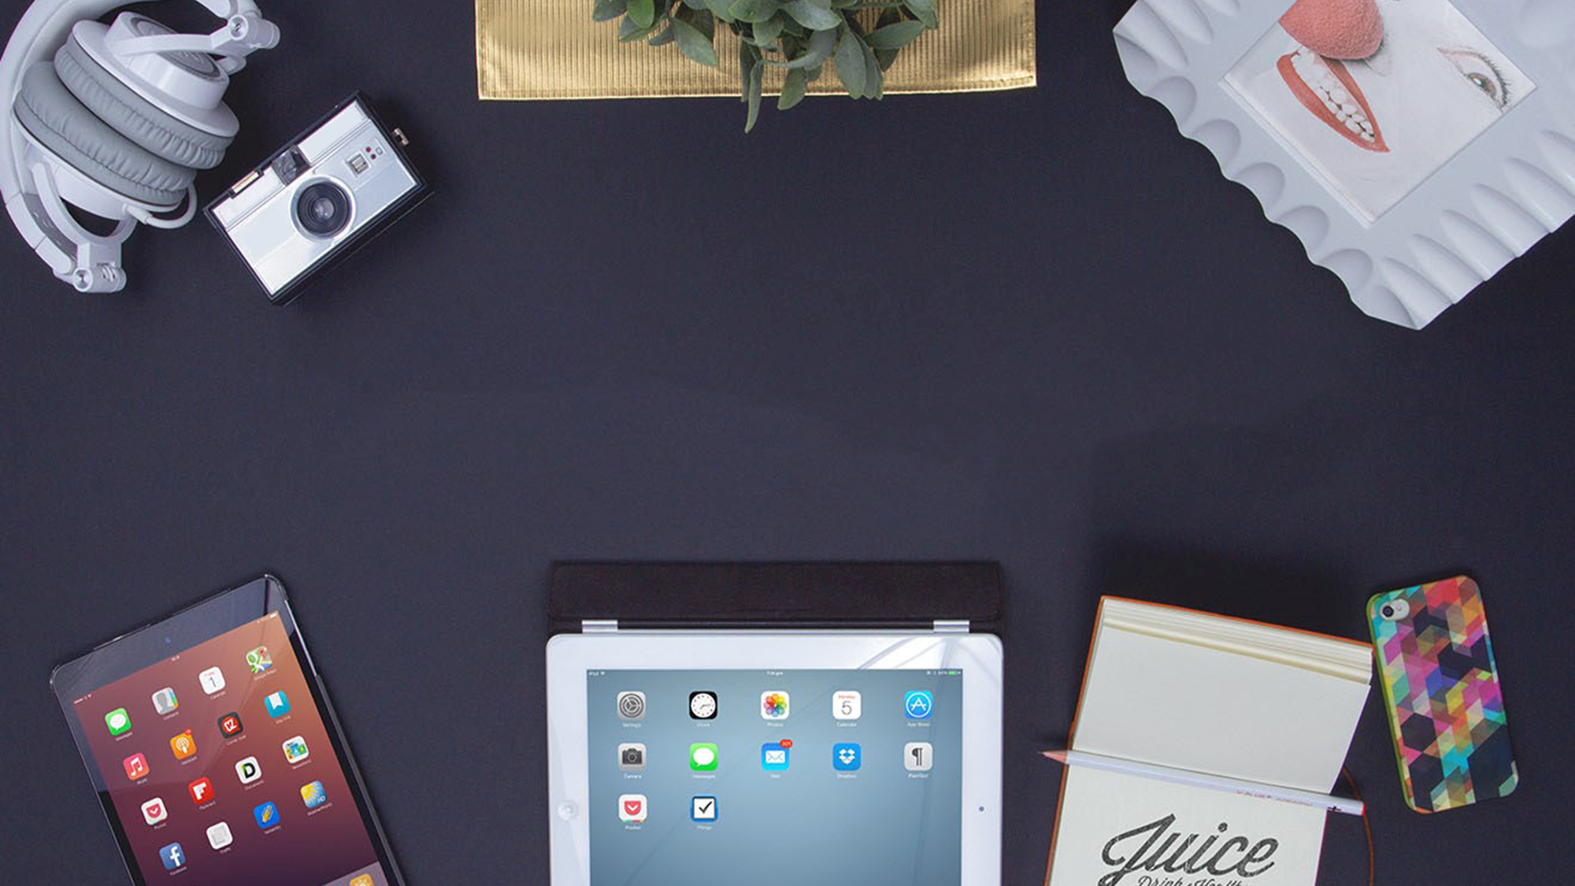

END
THANK YOU ALL!

